Slide 1

What trends do you notice?
How is the data presented?
Notes:
I posted this around the classroom and had the students travel to interact with the data

Slide 2
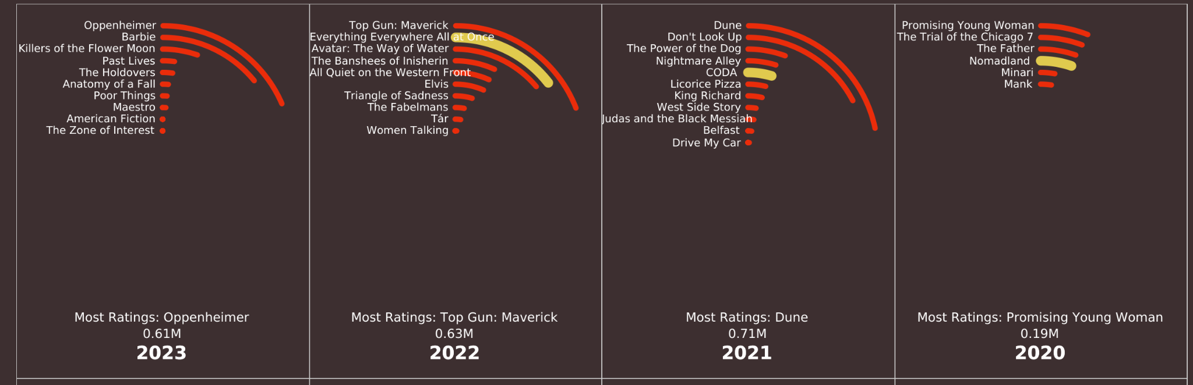
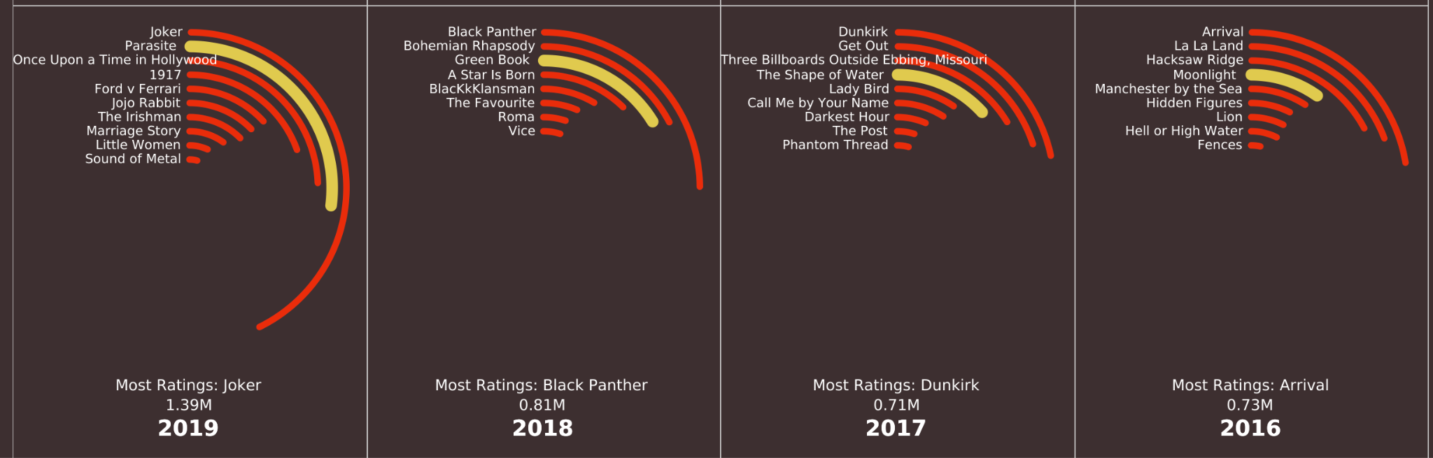

Slide 3
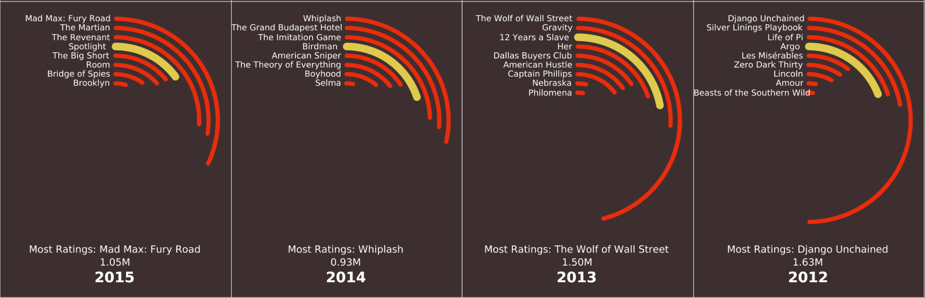
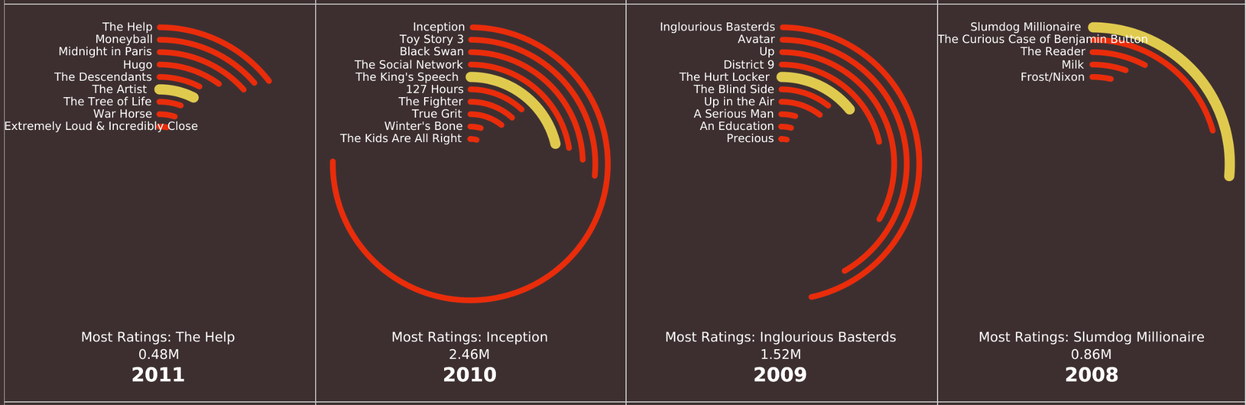

Slide 4
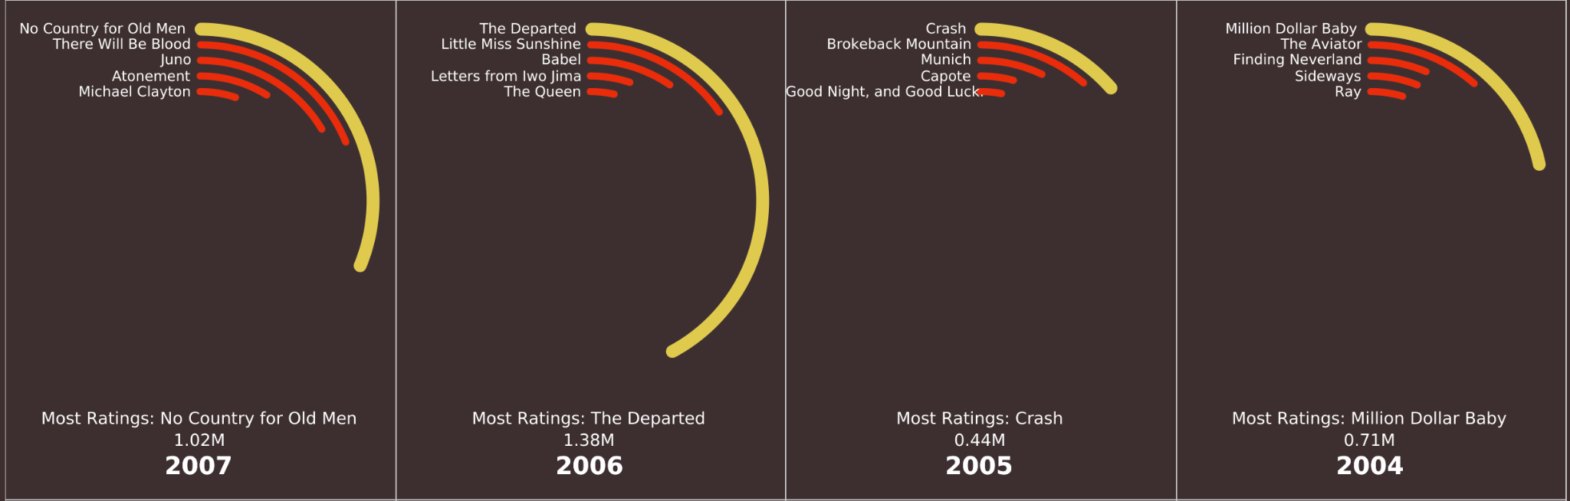
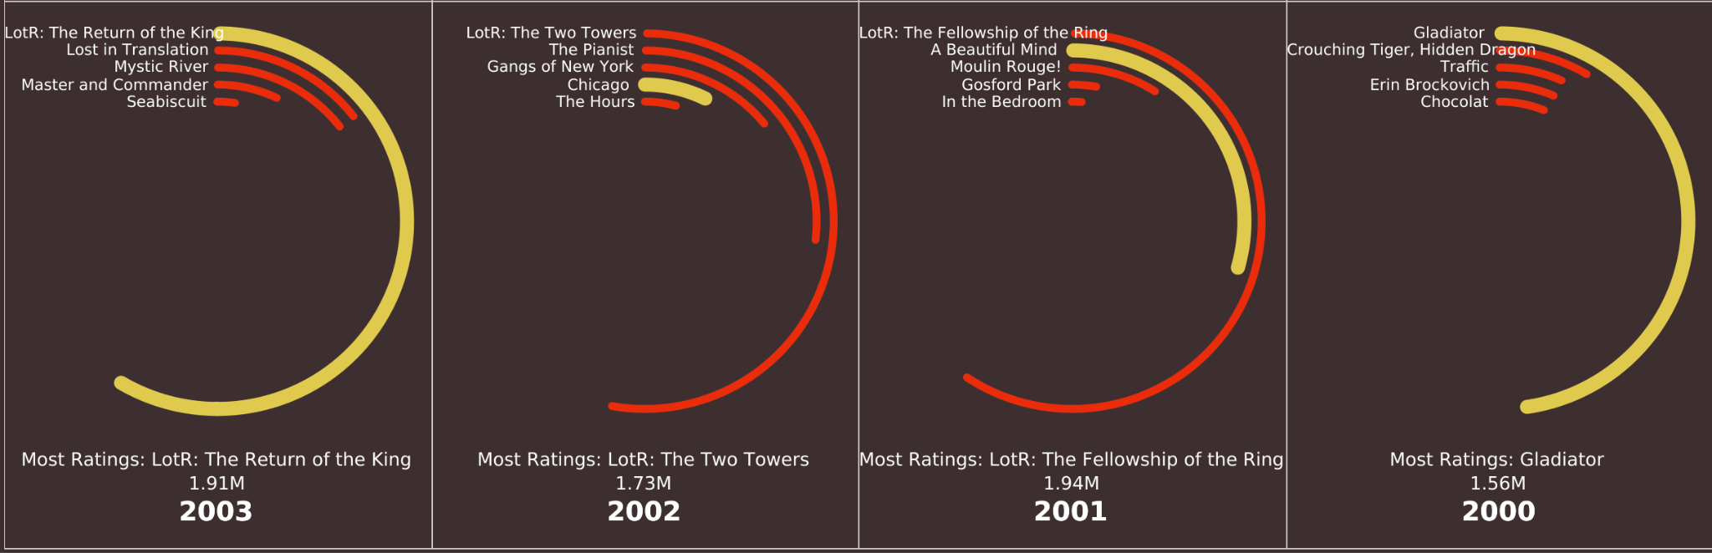

Slide 5
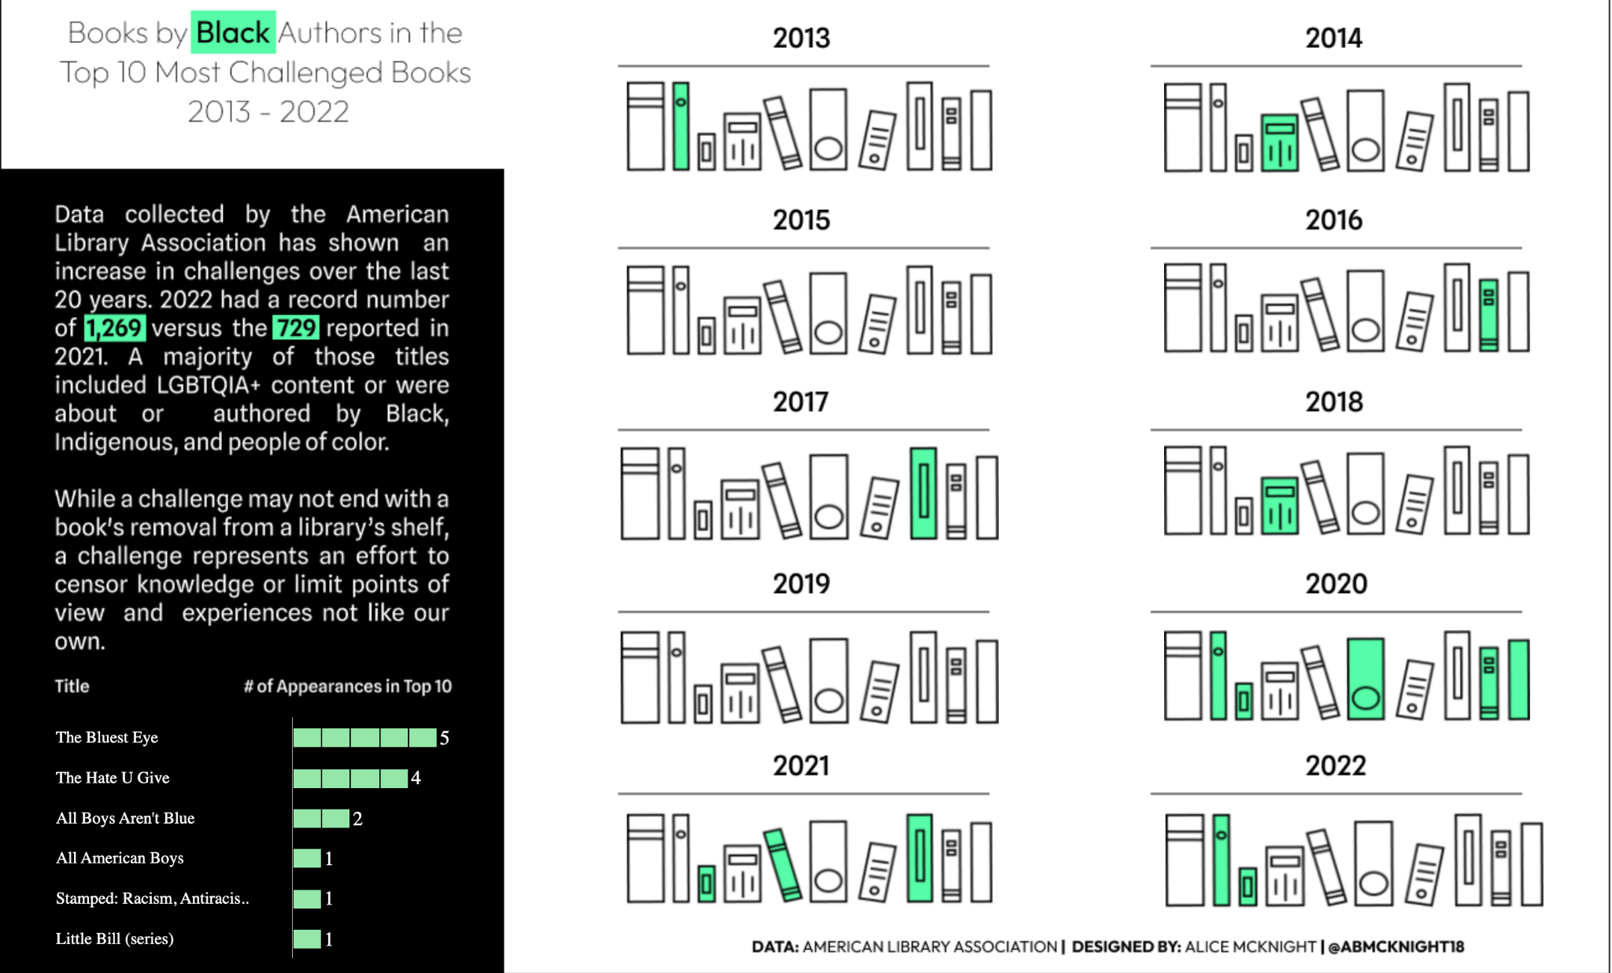
https://public.tableau.com/app/profile/alice.mcknight/viz/BannedBooksImage/BannedBooks

Slide 6
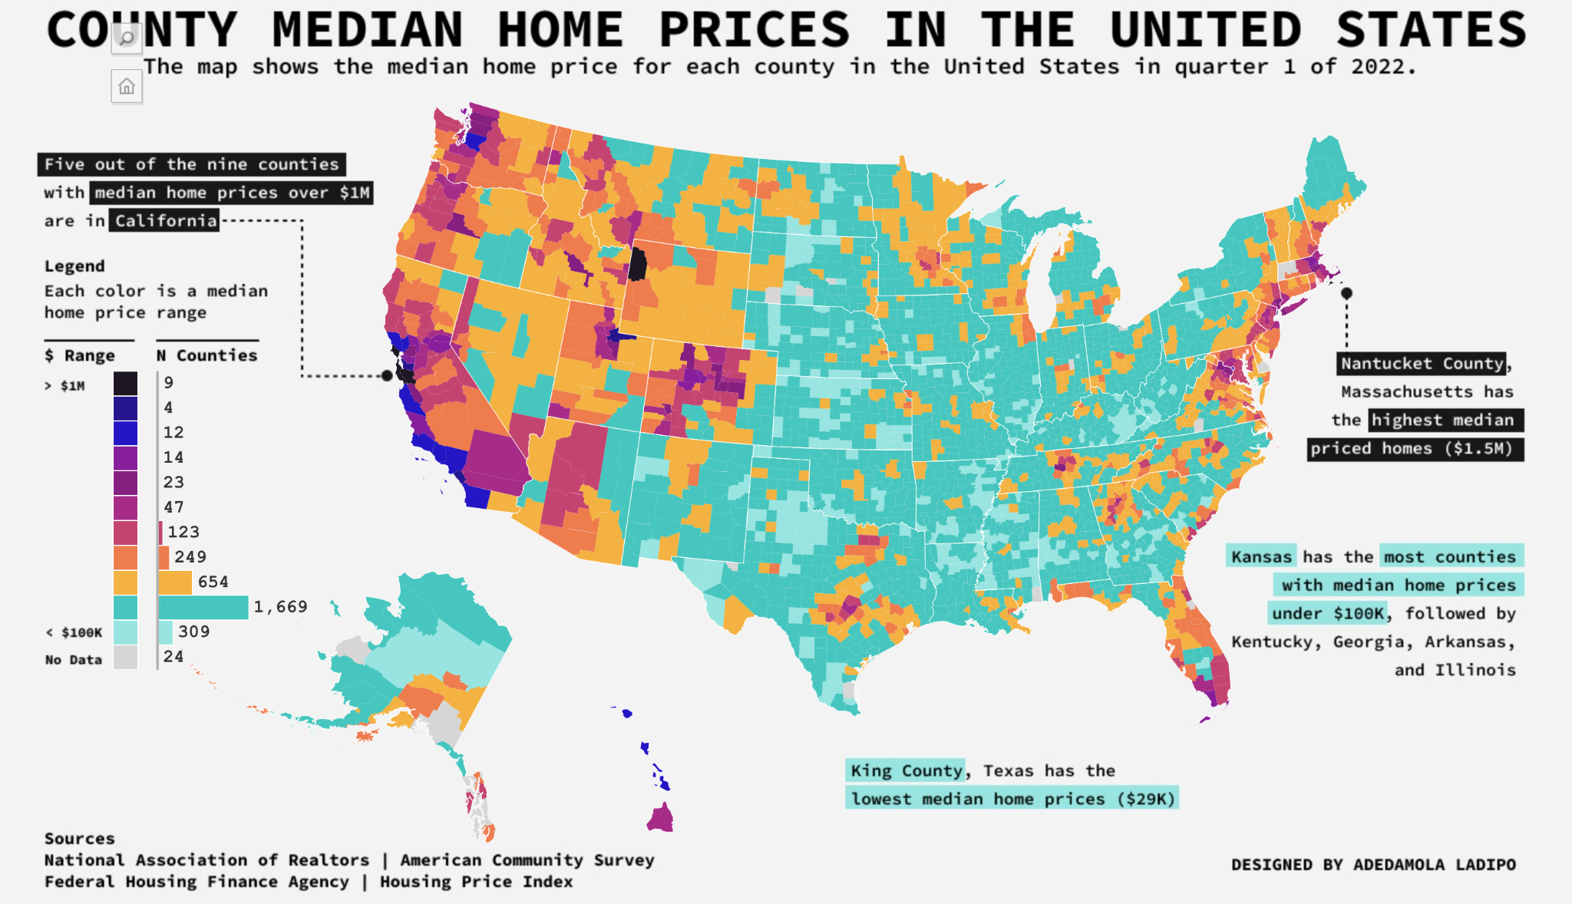
https://public.tableau.com/app/profile/adedamola8122/viz/MedianHomePriceQ12022/AlternativeMapProjection-County

Slide 7
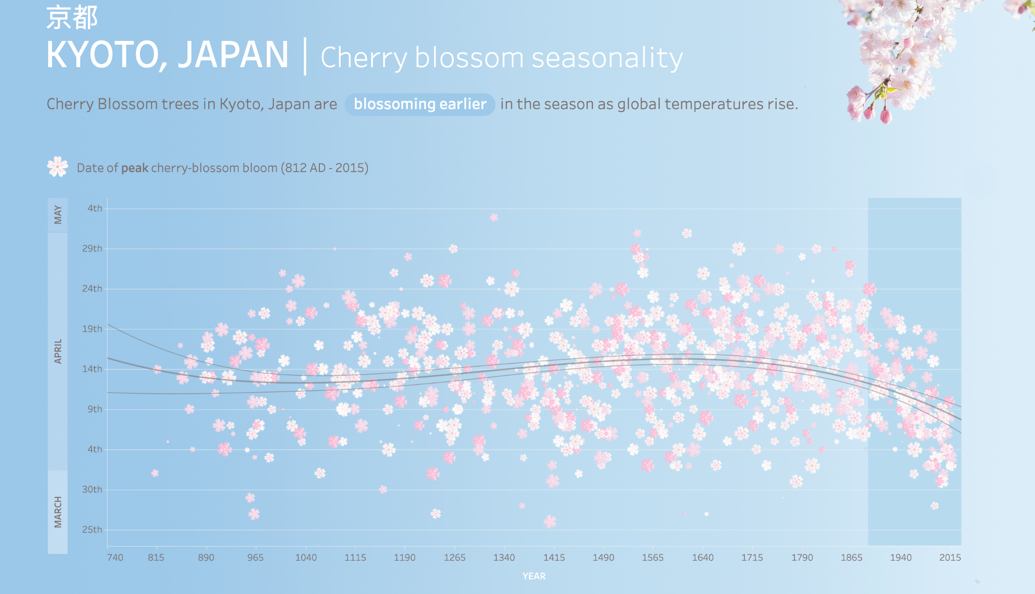

Slide 8
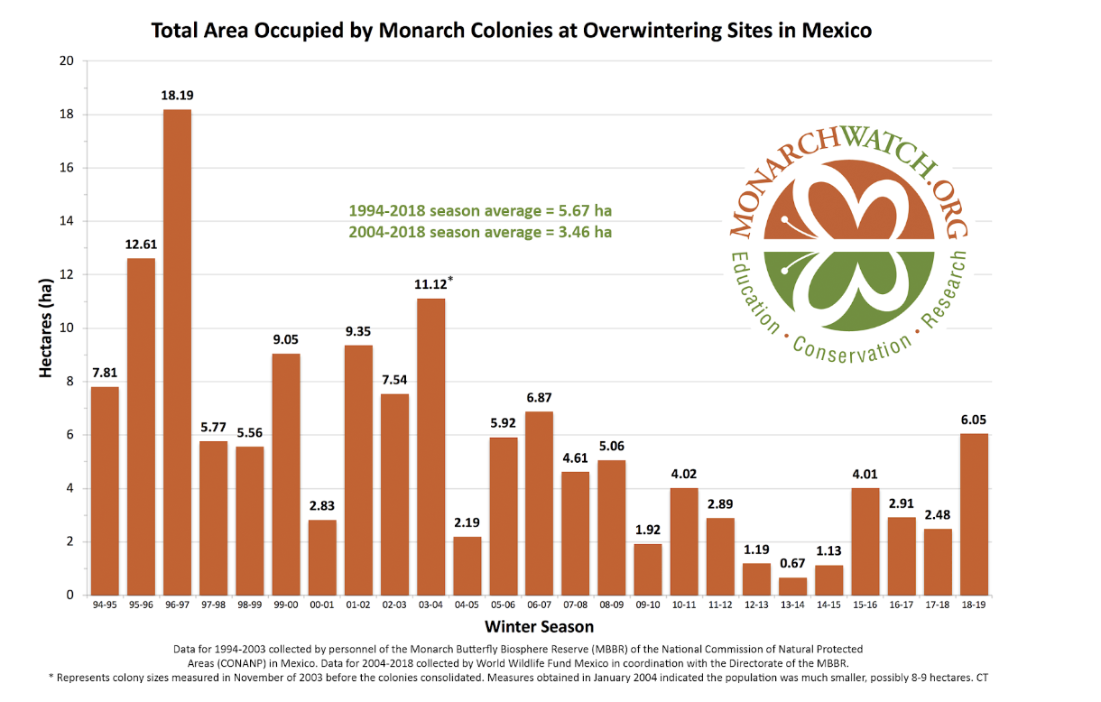
Monarch Evidence Data Set

Slide 9
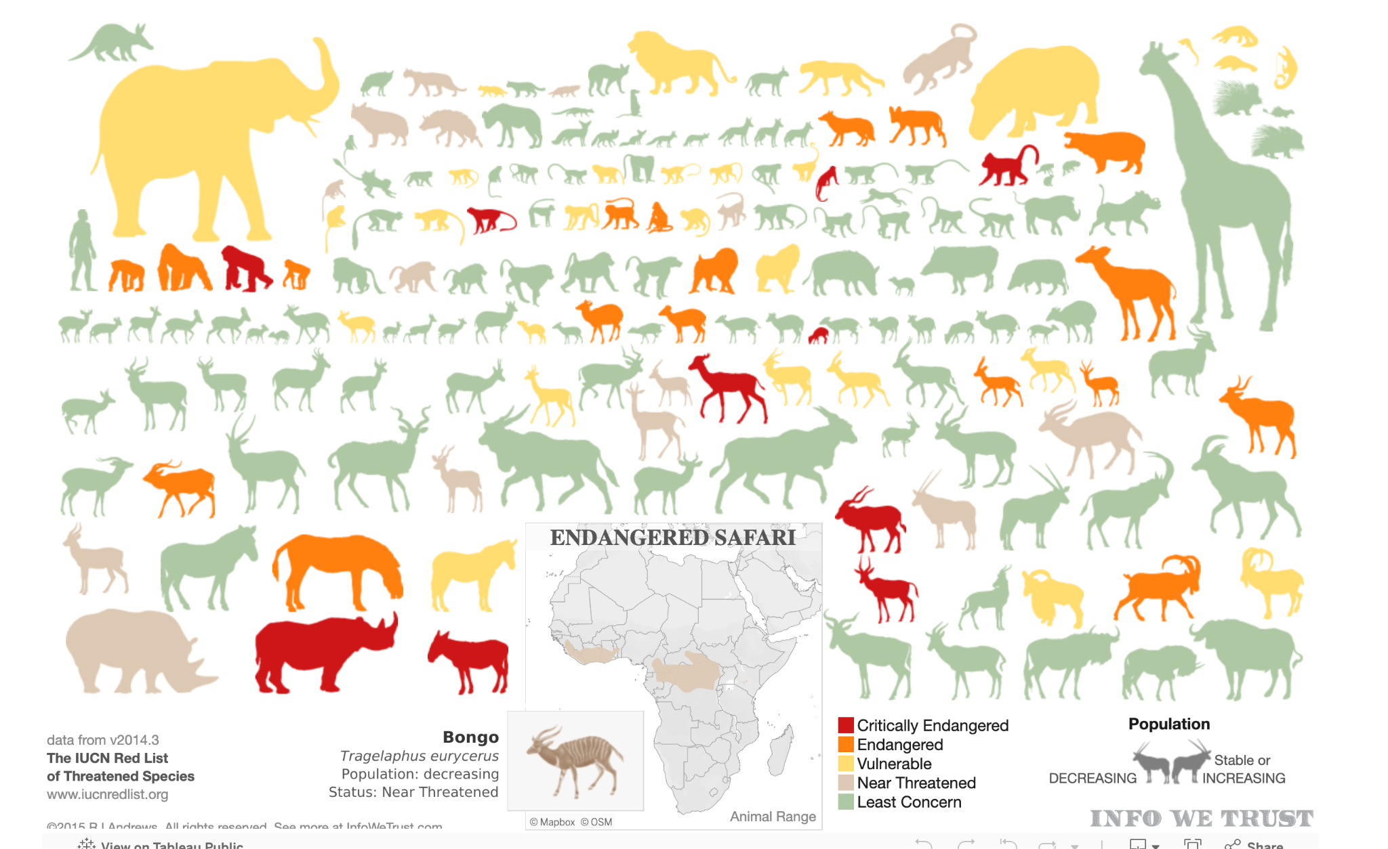
https://public.tableau.com/app/profile/rj.andrews/viz/ENDANGEREDSAFARI/ENDANGEREDSAFARI

Slide 10
https://public.tableau.com/app/profile/datavizard/viz/StarWars-ScreenTimeAnalysis/StarWars

Slide 11
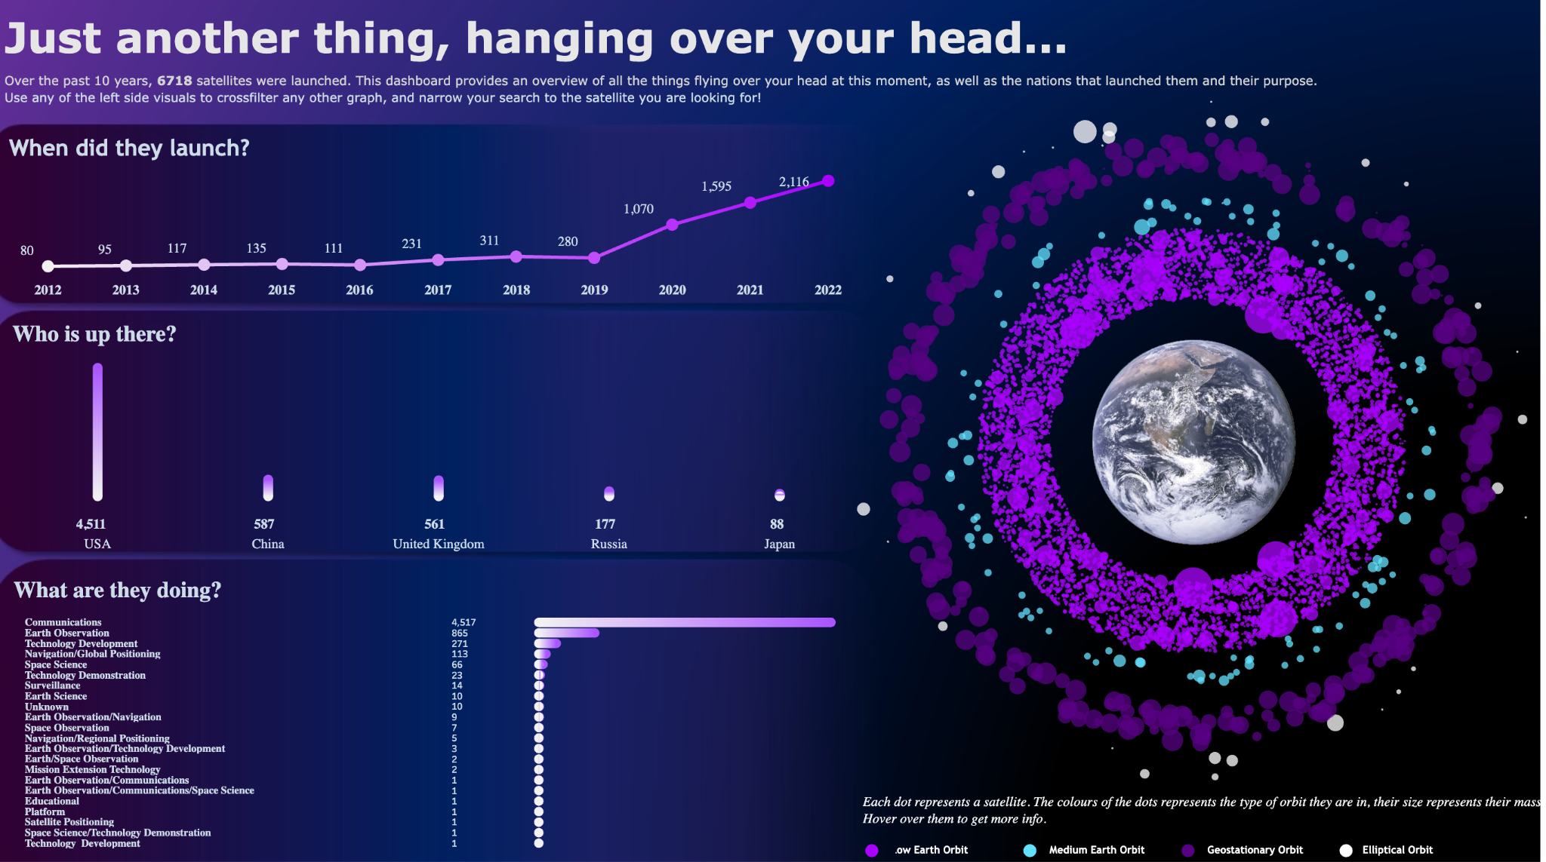
Notes:
Just another thing, hanging over your head | Tableau Public

Slide 12
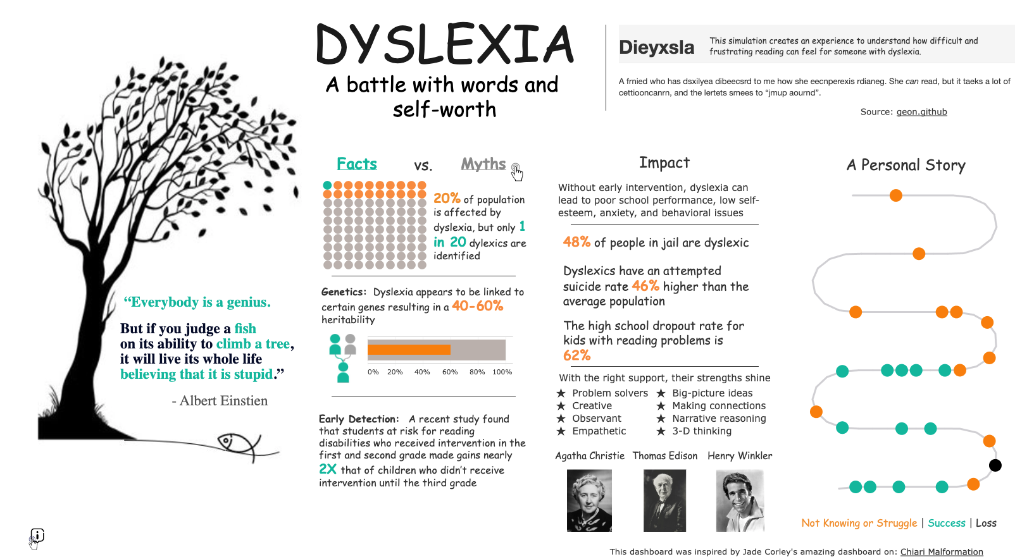
https://public.tableau.com/app/profile/jennifer.cook/viz/Dyslexiaabattlewithwordsandself-worth/DyslexiaWordsandSelfWorth

Slide 13
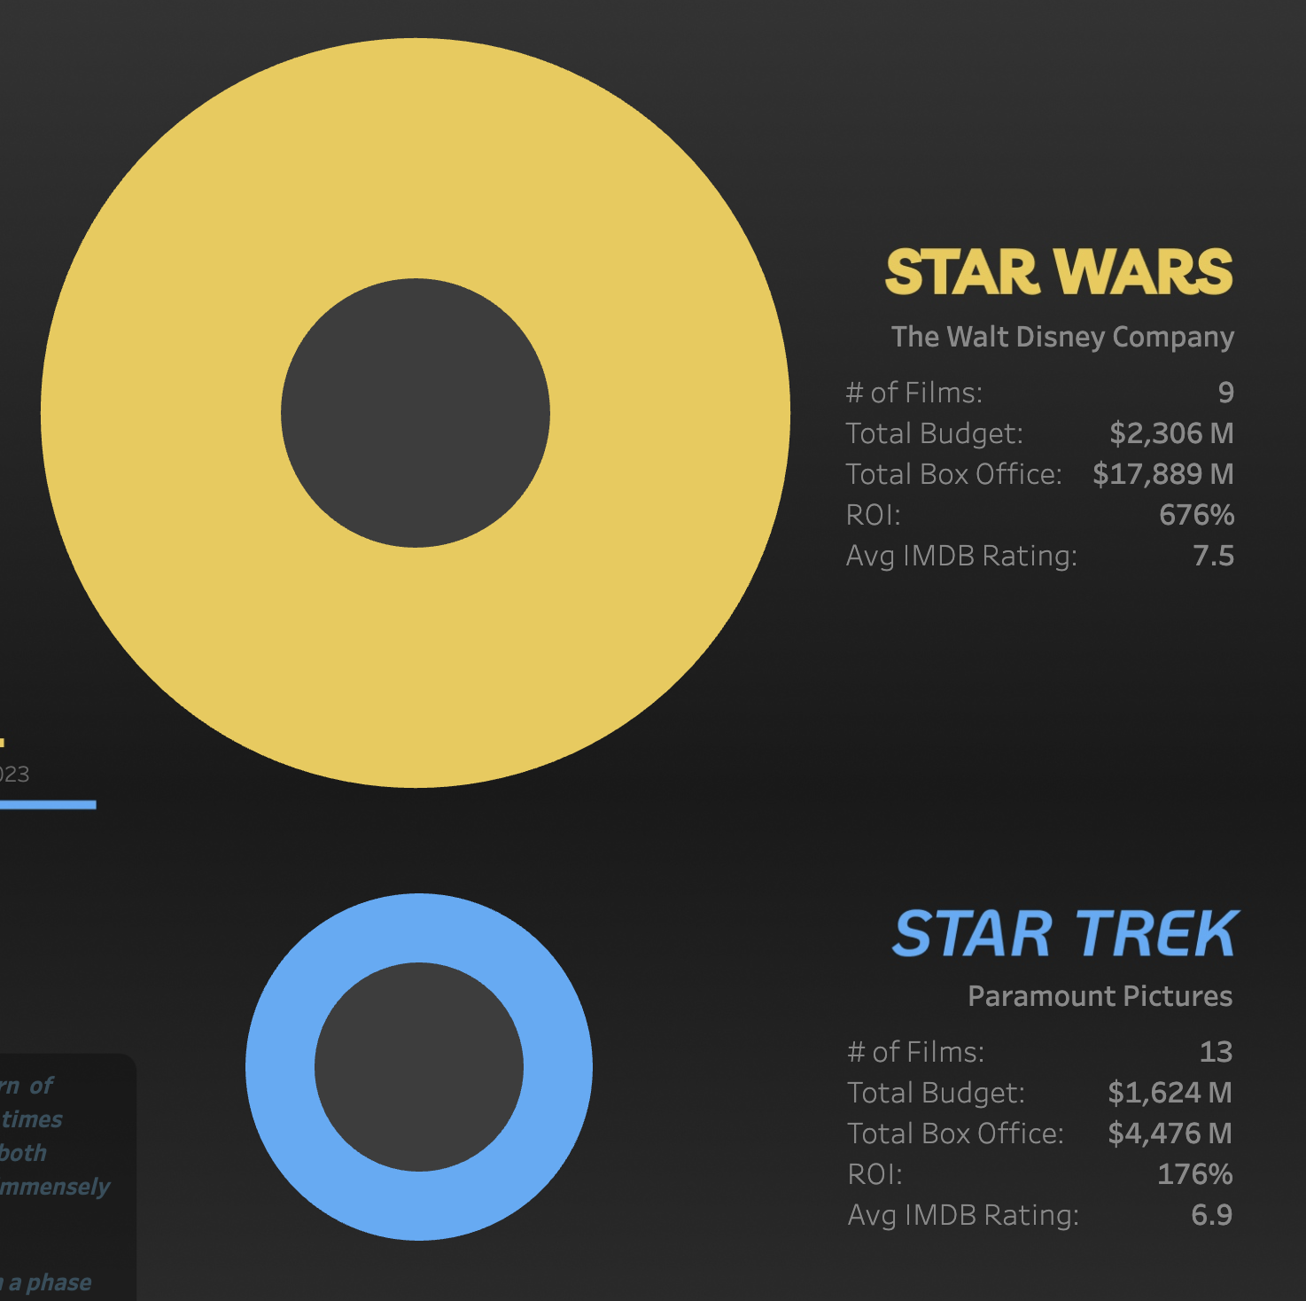
STAR WARS vs STAR TREK - #DataPlusMovies #VOTD | Tableau Public

Slide 14
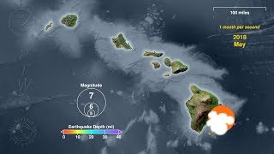
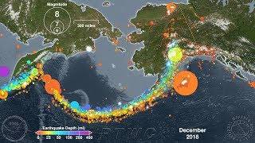
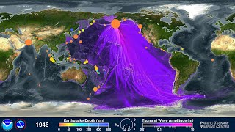
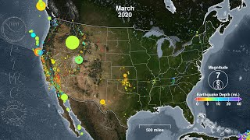

Slide 15
Data sets for phenomena
https://thewonderofscience.com/datasets#middleschool

Slide 16
https://public.tableau.com/app/profile/joshpreston/viz/BestPictureAcademyAwards2000-2023DataPlusMovies/Dashboard1

